Slide 1
Stratification discussion

Slide 2
Identifying Certainty Strata
Combination of evaluating method results & professional judgment
Units in Certainty Strata are the big ones in the tail of distribution
Have a large effect on the mean and total estimates so they should be included
Since they are spread out, sampling them will not reduce the variance – goal of stratification
Exactly where to draw the line for certainty units requires professional judgment and possibly evaluating results of methods to form strata cutoffs

Slide 3
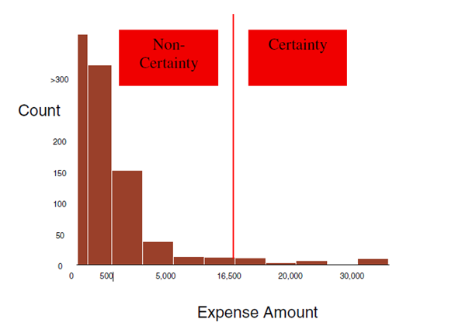
Identifying Strata: Original Distribution

Slide 4
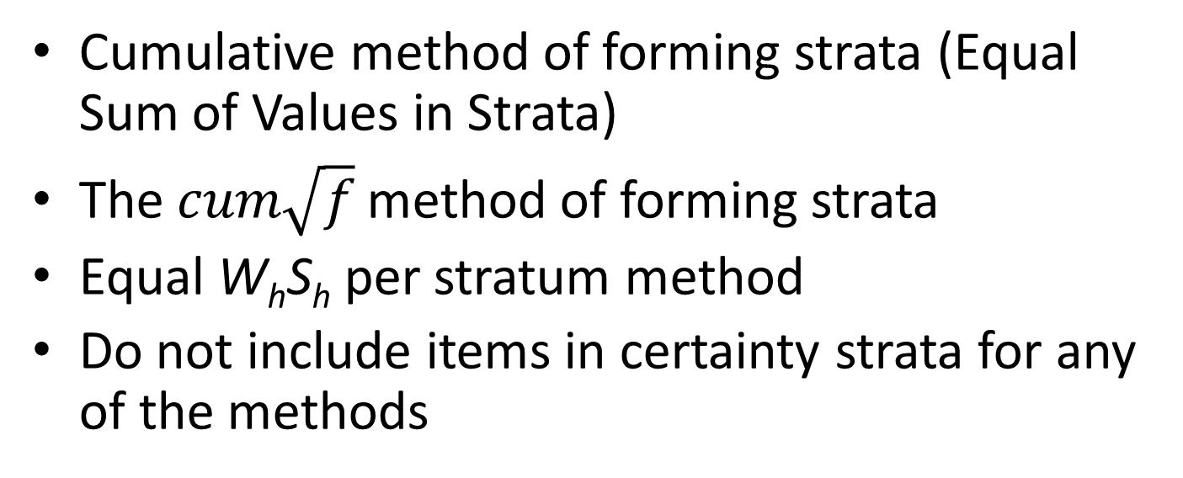
Methods for Finding Strata Cutoffs
Cumulative method of forming strata (Equal Sum of Values in Strata)
The $cum\sqrt{f}$ method of forming strata
Equal W_{h}S_{h} per stratum method
Do not include items in certainty strata for any of the methods

Slide 5
Steps in Cumulative Method of Forming Strata
Use only elements in non-certainty strata.
Sort the data in ascending order.
Calculate the sum of all the elements.
Divide this sum by the number of strata to get the length of the strata interval.
Create the cumulative distribution of values of the elements.
Assign the elements to strata based on the strata interval and cumulative distribution.

Slide 6
Example: Cumulative Method of Forming Strata

Slide 7
Steps in The $cum\sqrt{f}$ method of forming strata
Use only elements in non-certainty strata.
Sort the data in ascending order.
Assign elements to classes such that the interval for all classes is the same (See example with 20 classes).
The easiest way to do this is in terms of percentages of the population total of the variable used in designing the strata. For example 0 to 5% of the total, 5% to 10% of the total and so on until the last range is 95% to 100% of the total.
If you do not have equal intervals for classes you will have to make an adjustment in the calculations as described in the note on the next slide. We do not have to worry about this for our purposes.
Count the number of elements in each percentile and take the square root of this number, call it sqrt(f(y)).
Calculate the cumulative sqrt(f(y)) for each percentile.
Divide the total cumulative sqrt(f(y) by the number of strata. We will call this the D.
The cumulative sqrt(f(y)) cutoffs are given by:
cutoff_{i} = i*D I = 1, … , H
Assign the number elements in each stratum using the closet cumulative sqrt(f(y) value to the cutoffs

Slide 8
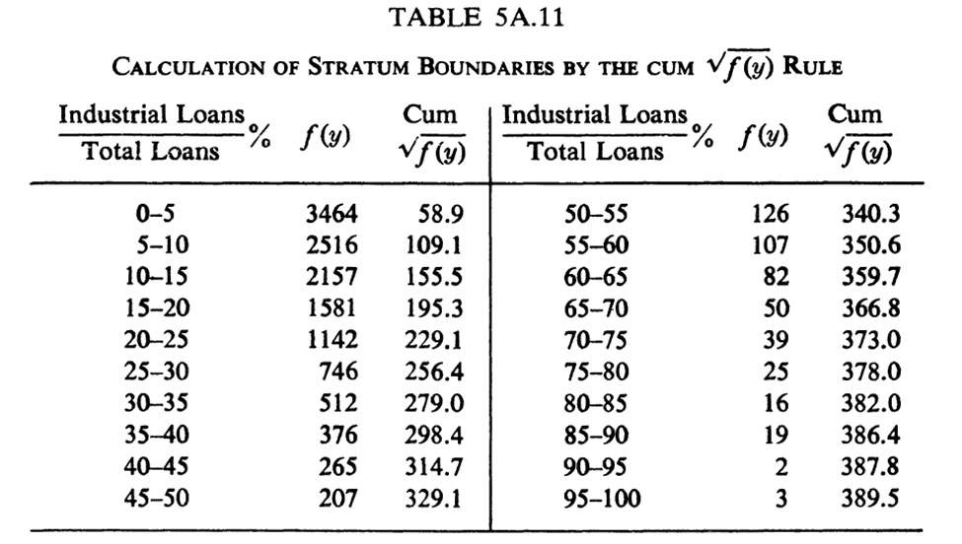
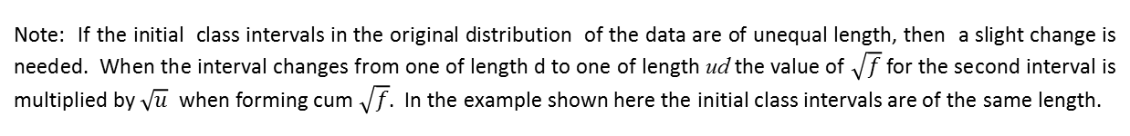
Example for the $cum\sqrt{f}$ method of forming strata
These are classes based on each item's % of total
D = 389.5/5 = 77.9
These are number items in the classes
Cum sqrt(f(y) number closest to Strata x D
Note: If the initial class intervals in the original distribution of the data are of unequal length, then a slight change is needed. When the interval changes from one of length d to one of length ud the value of $\sqrt{f}$ for the second interval is multiplied by $\sqrt{u}$ when forming cum $\sqrt{f}$. In the example shown here the initial class intervals are of the same length.

Slide 9
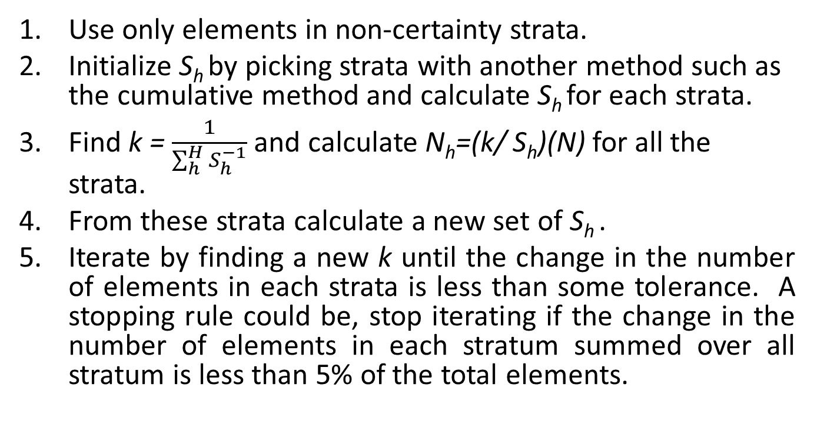
Steps in Equal W_{h}S_{h} per stratum method
Use only elements in non-certainty strata.
Initialize S_{h} by picking strata with another method such as the cumulative method and calculate S_{h} for each strata.
Find k = $\frac{1}{\sum_{h}^{H}{S_{h}^{−1}}}$ and calculate N_{h}=(k/ S_{h})(N) for all the strata.
From these strata calculate a new set of S_{h} .
Iterate by finding a new k until the change in the number of elements in each strata is less than some tolerance. A stopping rule could be, stop iterating if the change in the number of elements in each stratum summed over all stratum is less than 5% of the total elements.

Slide 10
Example: Output Equal W_{h}S_{h} per stratum method

